Slide 1
Software Engineering and Professional Practice & Building Usable Software Dr Rami Bahsoon School of Computer Science University of Birmingham r.bahsoon@cs.bham.ac.uk
Unit 2: Light Introduction to Requirements Engineering

Slide 2
Objectives
To introduce the concepts of user and system requirements
To describe the process of engineering requirements
To describe functional and non-functional requirements
To explain how software requirements may be organised in a requirements document

Slide 3
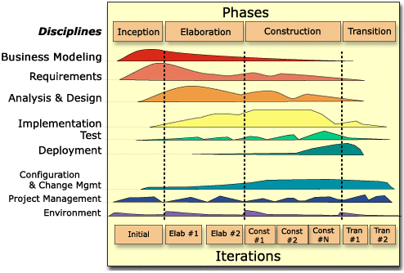
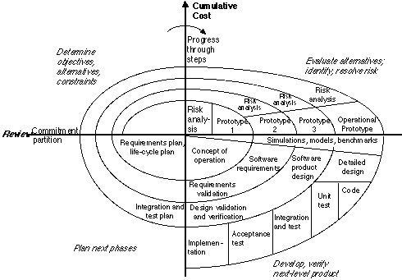
Last lectures

Slide 4
Requirements analysis and definition
The process of establishing what services are required and the constraints on the system’s operation and development.
What is the system about?
Requirements engineering process
Feasibility study (often done by business analysts)
Requirements elicitation and analysis;
Requirements specification;
Requirements validation.

Slide 5
Requirements Engineering Process
Activities
Coursework
Output

Slide 6
Brainstorming: What are requirements?
Consider you are developing Canvas system from scratch:
Users?
System/Environment?
Brainstorm the requirements of this system?

Slide 7
Requirements: “General” Statement
The system will maintain records of all library items including books, serials, newspapers, magazines, video and audio tapes,
No item shall be removed from the library without the details of its borrowing being recorded in the system
All items shall have a digital barcode containing a unique reference number
Could be “general” statements showing
how the system should maintain, monitor, achieve, interact with the user, other systems, and environment….

Slide 8
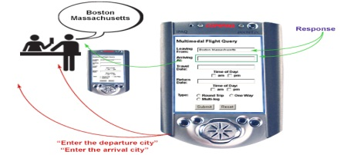
Requirements: “Detailed” Statements
Could be “detailed” statements of the system’s functionality FUNCTIONAL REQUIREMENTS
The system shall permit all users to search for an item by title, by author, by ISBN
Borrowed items that are one day overdue shall cause a reminder e-mail to the borrower
Could be statements of the practical constraints or limitations within which the system must operate --- Non-FUNCTIONAL REQUIREMENTS
The system shall respond to a transaction requests from a user within 1.5 seconds
Could be statements on how the system to be implemented --- Implementation REQUIREMENTS
When an item is borrowed or returned, it should be scanned through a card reader

Slide 9
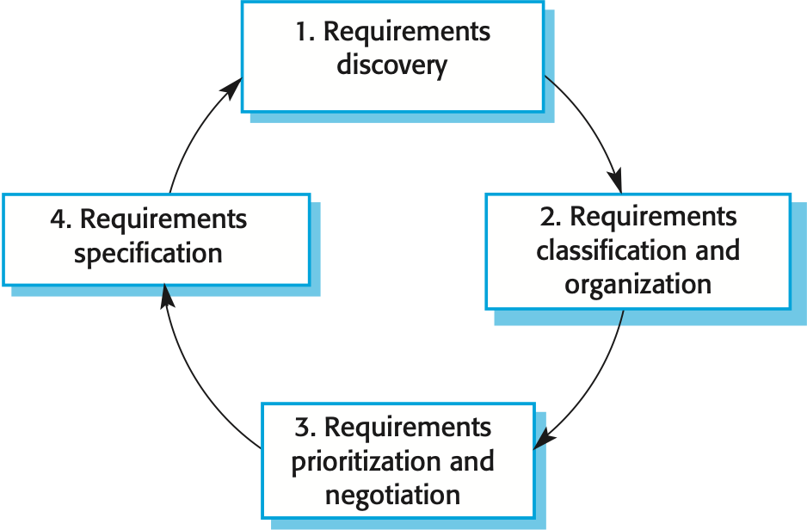
Eliciting/Discovering Requirements
Process of “capturing” or “discovering” requirements
Stakeholder consultations (interviews)
Scenarios (i.e., showing state of the system and flow of activities and events)
Observations
Revising existing documentations, manual system etc.

Slide 10
Eliciting and Discovering Requirements
Information about the required and existing systems
The requirements themselves are the descriptions of the system services and constraints that are generated during the requirements engineering process.
It may range from a high-level abstract statement of a service or of a system constraint to a low-level detailed functional and non-functional specification.
General rule: Abstract(General) and then refine(more detailed and specific)

Slide 11
Functional & Non-Functional Requirements
Functional requirements
Statements of services the system should provide, how the system should react to particular inputs
Non-functional requirements
Constraints on the services or functions offered by the system such as timing constraints, constraints on the development process, standards, etc.

Slide 12
Examples of Functional Requirements
The library system shall use a barcode scanner and keyboard input to record loan on books, journals, periodicals etc.
The library system shall provide a reminder when the book is overdue

Slide 13
Examples: Non-functional Requirements
The library system shall authenticate a library customer in five seconds or less
The library system shall be available 24/7
The library system shall abide to data protection act when keeping profile of users

Slide 14
More about Non-functional Requirements
These define system properties and constraints
E.g., reliability, security, availability, performance, response time
storage requirements. Constraints are I/O device capability, distribution paradigm etc.
Use of particular systems, programming language or development methods etc.
Non-functional requirements may be more critical than functional requirements. If these are not met, the system is useless.
[A constraint on how the functional requirements may be implemented]

Slide 15
Non-functional Requirement Types

Slide 16
Non-functional Classifications
Product requirements
Requirements which specify that the delivered product must behave in a particular way e.g. execution speed, reliability, etc.
Organisational requirements
Requirements which are a consequence of organisational policies and procedures e.g. process standards used, implementation requirements, etc.
External requirements
Requirements which arise from factors which are external to the system and its development process e.g. interoperability requirements, legislative requirements, etc.

Slide 17
Non-functional Requirements: Dimensions of Dependability

Slide 18
Other Dependability Properties
Repairability
Reflects the extent to which the system can be repaired in the event of a failure
Maintainability
Reflects the extent to which the system can be adapted to new requirements
Survivability
Reflects the extent to which the system can deliver services whilst under hostile attack
Error tolerance
Reflects the extent to which user input errors can be avoided and tolerated.

Slide 19
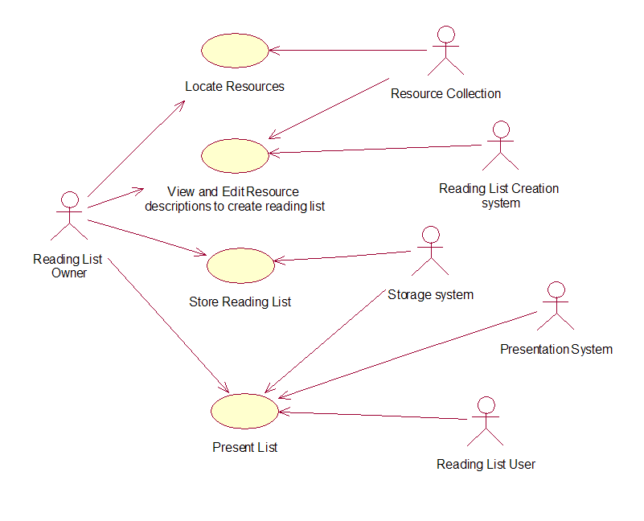
Definitions and Specifications
Statements in natural language..
Can be expressed in mathematical model…
Can be described in diagrams showing what the system provides and its operational constraints, showing behaviour, interaction…
Can be written in user stories, scenarios and use case specification…
Can be written in a formal languages (e.g., Abstract State Machines (ASMs); Alloy, B-method, Z-method)

Slide 20
Definitions and Specifications
Language!
ID

Slide 21
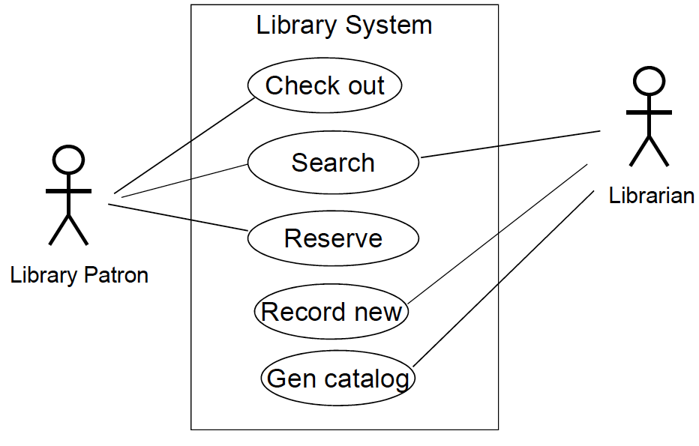
Use Cases Diagram (more details in following weeks)
High-level graphical model supplemented by more detailed tabular description
A fundamental feature of the Unified Modeling Language (UML).
Actor: human or other systems.
Interaction: a named ellipse.
Lines link the actors with the interaction.
Use case for library system

Slide 22
Requirements specification
Story: narrative text and high-level description of system use. (big picture)
Scenarios: parts of the story can be developed in more detail with specific information collected (e.g. inputs and outputs)

Slide 23
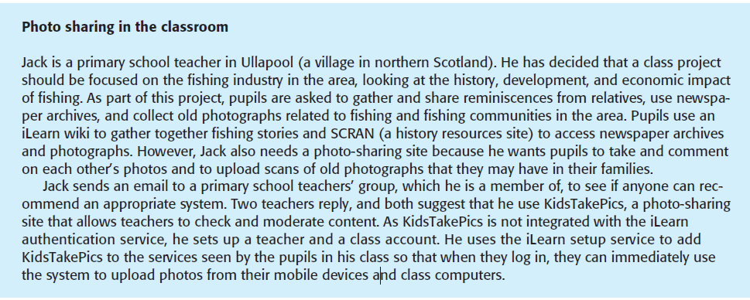
Example of User Story
A user story for the iLearn system of integrating KidsTakePics website

Slide 24
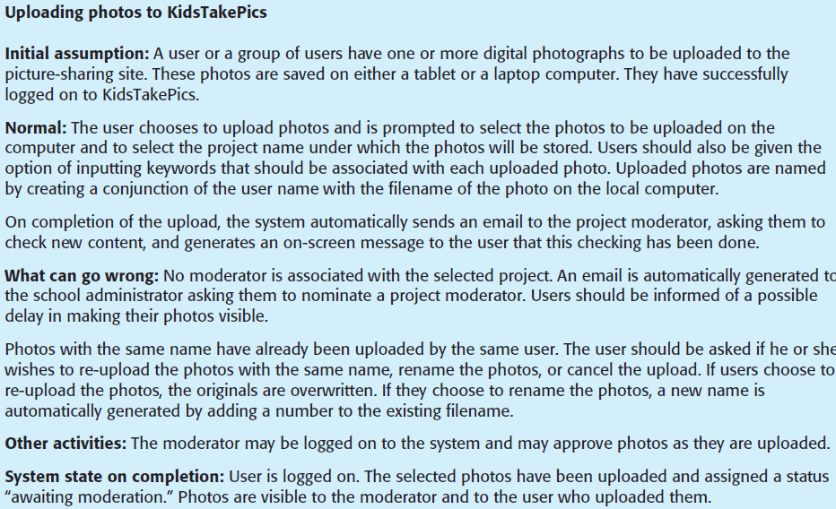
Scenario Example

Slide 25
Requirements Engineering Process
Activities
Coursework
Output

Slide 26
Requirements Validation
The process of ”debugging” requirements and check the system meets the customer needs
Requirements error costs are high so validation is very important
Fixing a requirements error after delivery may cost up to 100 times the cost of fixing an implementation error

Slide 27
Why to Validate Requirements?
Validity. Does the system provide the functions which best support the customer’s needs?
Consistency. Are there any requirements conflicts?
Completeness. Are all functions required by the customer included?
Realism. Can the requirements be implemented given available budget and technology?
Verifiability. Can the requirements be checked?

Slide 28
Issues in Requirements and Need for Validation
Ambiguity
The readers and writers of the requirement must interpret the same words in the same way.
Natural Language is naturally ambiguous so this is very difficult.
Over-flexibility
The same thing may be said in a number of different ways in the specification
Others - inconsistency, missing requirements, stakeholders’ bias, incompleteness, redundancy, irrelevance, overloaded statements….

Slide 29
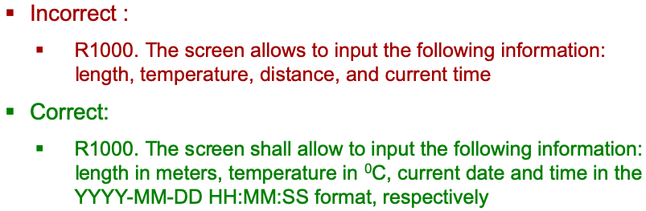
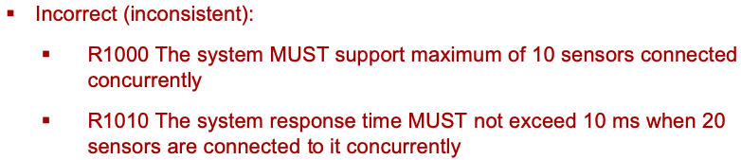
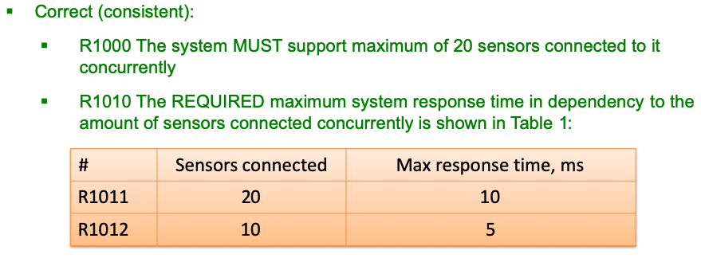
Examples of Validation

Slide 30
Requirements Validation Techniques
Validation techniques:
Requirements reviews: Systematic manual analysis of the requirements.
Prototyping: Using an executable model of the system to check requirements.
Test-case generation: Developing tests for requirements to check testability.

Slide 31
Requirements Engineering Process
Activities
Coursework
Output

Slide 32
Requirements Document
A structured document setting out detailed descriptions of the system’s functions, services and operational constraints.
Should include both a definition of user requirements and a specification of the system requirements.
It is NOT a design document. As far as possible, it should set of WHAT the system should do rather than HOW it should do it
Defines what should be implemented so may be part of a contract between client and contractor.

Slide 33

Users of a Requirements Document

Slide 34
MoSCoW Criteria: Prioritisation
Often used in requirements prioritization and as a language for specifying requirements
M: Must have- mandatory requirements that are fundamental to the system
S: Should have – important requirements that could be omitted
C: Could have – optional requirements
W: Want to have – these requirements really can wait (i.e. bells and whistles)

Slide 35
Example Format
ID | Functional Requirements | Priority
1 | The system shall… | M
2 | The system shall ….
Collection
Borrowing
Membership
Borrowing

Slide 36
Non-functional Requirements
ID | Non-functional Requirements | Priority
1 | The system shall… | M
2 | The system shall ….
3
4
Capacity
Reliability
Borrowing
Performance

Slide 37
Requirements Management and Change
The process of managing changing requirements during the requirements engineering process and system development.
Change is inevitable, especially for large systems:
The business and technical environment of the system always changes
Large systems usually have a diverse user community, with many users having different requirements and priorities that may be conflicting or contradictory. It can change overtime

Slide 38
How to Manage Change in Requirements?
Traceability: keep track of individual requirements
Dependency: maintain links between dependent requirements
Change impact analysis: assess the impact of requirements changes
Establish a formal process for making change proposals and linking these to system requirements.

Slide 39
Why are Requirements Important?
“The hardest single part of building a software system is deciding precisely what to build. No other part of the conceptual work is as difficult as establishing the detailed technical requirements, including all the interfaces to people, to machines, and to other software systems. No other part of the work so cripples the resulting system if done wrong. No other part is more difficult to rectify later”
[Fred Brooks in the “Mythical Man Month”]
Read this article!

Slide 40
Exercise
Determine a set of functional and non-functional requirements for facebook
Work in a group of two…
What you have to do
Express the functional & non-functional requirements with a unique ID for traceability
Group your requirements into sensible sets (e.g., user interface, profile, posting, friends, customising etc)
Prioritise your requirements

